Slide 1

ST1 Capstone Project
Luke Giessmann u3205042
Wednesday – 2:30 – 4:30pm

Slide 2
Table of Contents
1. Introduction
2. Dataset Details
3. EDA Outcomes
4. PDA Outcomes
5. Implementation and Deployment
6. References

Slide 3
1. Introduction
Perform EDA and PDA on a dataset.
Use machine learning to produce a Tkinter GUI program.
Convert the program to a web application.
Document the process in a report.

Slide 4
2. Dataset Details
Disease Symptoms and Patient Profile Dataset.
Has 10 columns.
Contains many different diseases including Asthma, Eczema and Influenza.
Confirms whether a patient is suffering from symptoms.
Checks Blood pressure and cholesterol levels.

Slide 5
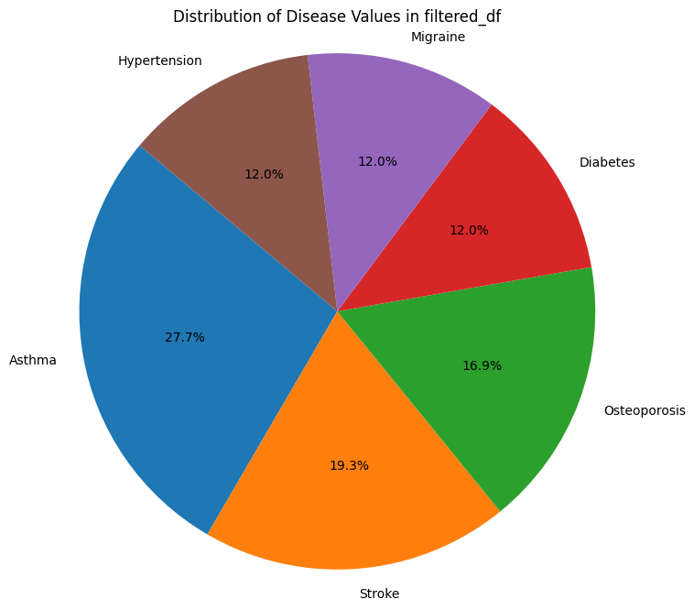
3. EDA Outcomes
Many the diseases were low frequency.
Down from 349 entries to 83 entries.
High frequency diseases were Asthma, Hypertension, Migraine, Diabetes, Osteoporosis and Stroke.

Slide 6
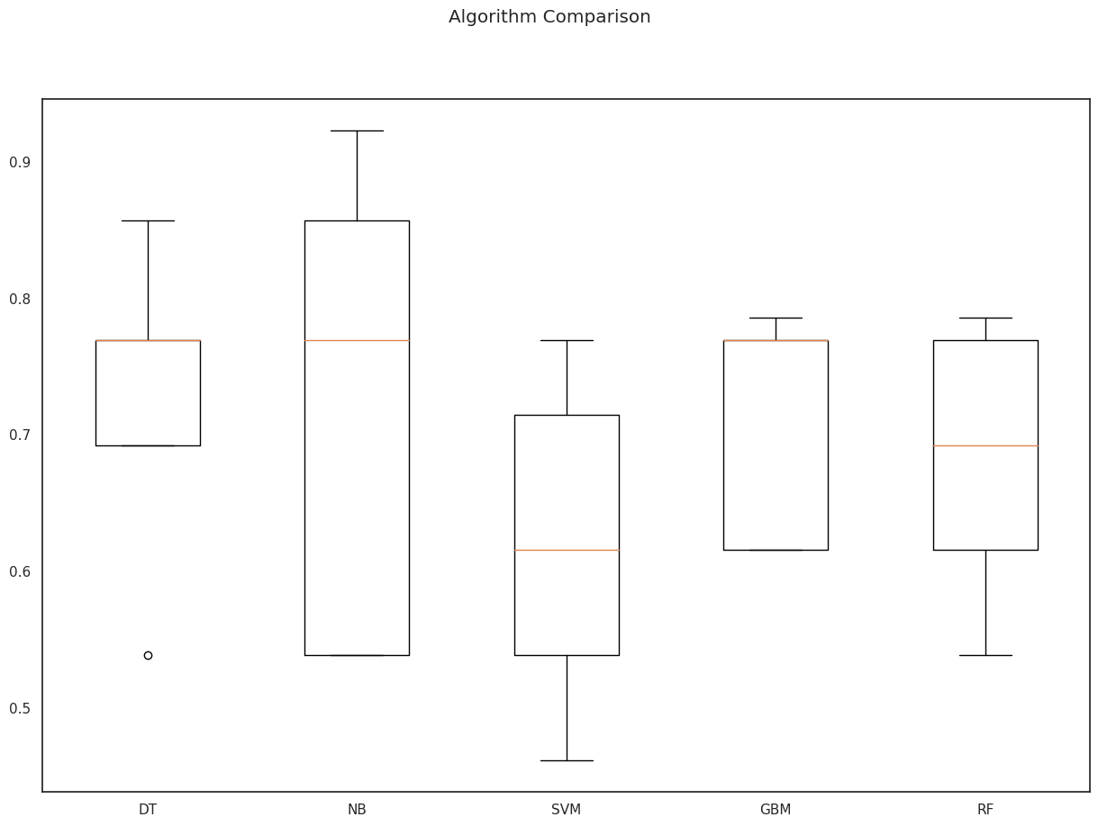
4. PDA Outcomes
Best algorithm was determined to be GBM / GB.
NB and DT were close but had a larger spread in accuracy of predictions.

Slide 7
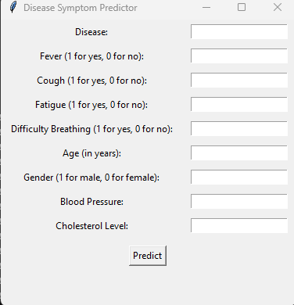
5. Implementation And Deployment
Limited Diseases to those of frequency 10 or higher in dsp_model
Converted non numerical values into numerical values.
Used Flask to host program as a web application.

Slide 8
References
[1] https://uclearn.canberra.edu.au/courses/14056/files/4341922
[2] “Disease Symptoms and Patient Profile Dataset,” www.kaggle.com. https://www.kaggle.com/datasets/uom190346a/disease-symptoms-and-patient-profile-dataset
[3]“pandas: powerful Python data analysis toolkit — pandas 0.25.3 documentation,” Pydata.org, 2019. https://pandas.pydata.org/pandas-docs/stable/index.html
[4] https://uclearn.canberra.edu.au/courses/14056/files/4190046
[5] https://uclearn.canberra.edu.au/courses/14056/assignments/110915
[6] tutorialspoint.com, “Python GUI Programming (Tkinter),” www.tutorialspoint.com, 2019. https://www.tutorialspoint.com/python/python_gui_programming.htm
[7] “self in Python class,” GeeksforGeeks, Mar. 10, 2019. https://www.geeksforgeeks.org/self-in-python-class/
[8] “Web forms — Working with user data - Learn web development | MDN,” developer.mozilla.org. https://developer.mozilla.org/en-US/docs/Learn/Forms
[9] “Quickstart — Flask Documentation (2.1.x),” flask.palletsprojects.com. https://flask.palletsprojects.com/en/2.1.x/quickstart/
[10] W3Schools, “HTML Tutorial,” W3schools.com, 2022. https://www.w3schools.com/html/default.asp

